Slide 1

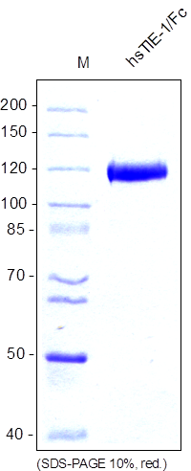
Reliatech GmbH
Human soluble TIE1-Fc Chimera (Insect cells)
(Cat# SFC-011 / SFC-012))
Figure 1: SDS-PAGE analysis of recombinant human sTIE-1/Fc Chimera produced in insect cells. Sample was loaded in 10% SDS-polyacrylamide gel under reducing conditions and stained with Coomassie blue.
http://www.reliatech.de / orders@reliatech.de

